Slide 1
Getting into debt
What is the best indicator of whether someone will pay next month?
Secondary questions:
Does Gender, Education Level, Marital Status or Age impact failure to pay?

Slide 2


Slide 3

The Data Set
UCI Machine Learning Repository
Default of Credit Card Clients Data Set
Rows = 30,000
Features = 23
NaN = 0
Unbalanced
Will a customer default?

Slide 4
The Challenge
“Among the six data mining techniques, artificial neural network is the only one that can accurately estimate the real probability of default.”

Slide 5
Features
X 1: Amount of the given credit (NT dollar): it includes both the individual consumer credit and his/her family (supplementary) credit.
X 2: Gender (1 = male; 2 = female).
X 3: Education (1 = graduate school; 2 = university; 3 = high school; 4 = others).
X 4: Marital status (1 = married; 2 = single; 3 = others).
X 5: Age (years)
X 6 - X11: Delay in past payments X6 = Sep-05 onwards
X 12-X17: Amount of bill statement
X18-X23: Amount of previous payment X18 = amount paid in Sep-05

Slide 6
The Process
Which Data Mining Technique is best?
Decision Tree Classifier (Gini)
Decision Tree Classifier (Entropy)
Random Forest (Entropy)
XGBClassifier
Neural Network (701 parameters)
Does balancing with RandomUnderSampler help?
Using 10% test data

Slide 7
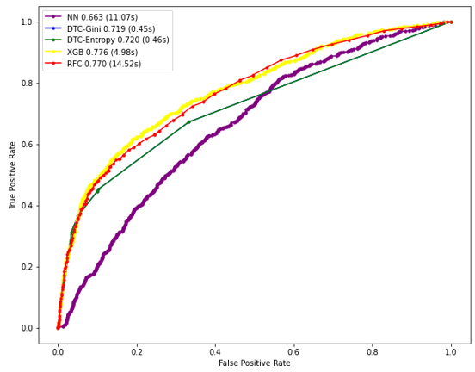
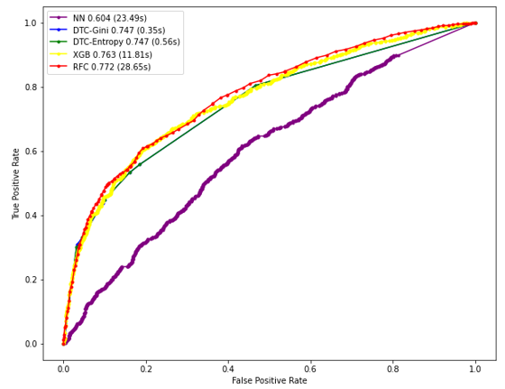
Predication AOC
With raw data
With under sampling

Slide 8
Nice but… what’s the accuracy?
Method | Accuracy | Precision | Recall
Decision Tree Classifier (Gini) | 82.13 | 0.67 | 0.37
Decision Tree Classifier (Enropy) | 82.12 | 0.67 | 0.37
Random Forest | 81.90 | 0.65 | 0.37
XGB Classifier | 82.17 | 0.66 | 0.38
Neural Network | 75.33 | 0.37 | 0.17

Slide 9
Isn’t precision more important?
Method | Accuracy | Precision | Recall
Decision Tree Classifier (Gini) | 82.13 | 0.67 | 0.37
Decision Tree Classifier (Enropy) | 82.12 | 0.67 | 0.37
Random Forest | 81.90 | 0.65 | 0.37
XGB Classifier | 82.17 | 0.66 | 0.38
Neural Network | 75.33 | 0.37 | 0.17

Slide 10
Isn’t precision more important?
Method | Accuracy | Precision | Recall
Decision Tree Classifier (Gini) | 82.13 | 0.67 | 0.37
Decision Tree Classifier (Enropy) | 82.12 | 0.67 | 0.37
Random Forest | 81.90 | 0.65 | 0.37
XGB Classifier | 82.17 | 0.66 | 0.38
Neural Network | 75.33 | 0.37 | 0.17

Slide 11
Isn’t precision more important?
Method | Accuracy | Precision | Recall
Decision Tree Classifier (Gini) | 82.13 | 0.67 | 0.37
Decision Tree Classifier (Enropy) | 82.12 | 0.67 | 0.37
Random Forest | 81.90 | 0.65 | 0.37
XGB Classifier | 82.17 | 0.66 | 0.38
Neural Network | 75.33 | 0.37 | 0.17
We correctly predicted failure to pay 67% of the time.
Of all the failures to pay, we predicted 37% of them.

Slide 12
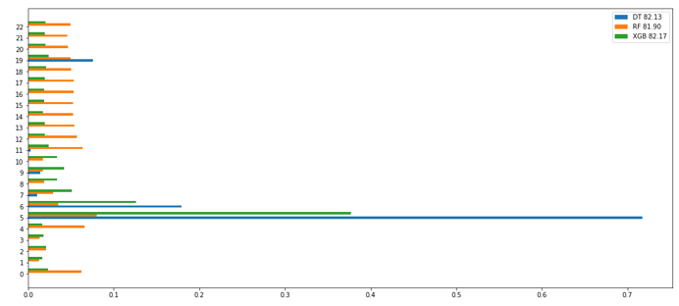
What’s the key predictor?
5 = Delay with previous payment (Sep-05)
6 = Delay in 2nd previous payment (Aug-05)
0 = Credit Limit

Slide 13
Conclusion
Failure to pay independent of
Gender
Education level
Marital status
Age

Slide 14
Conclusion
Failure to pay independent of
Gender
Education level
Marital status
Age
Failure to pay dependent on
Previous failure to pay history

Slide 15
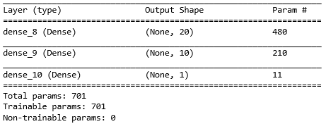
DS Conclusion
This is the Neural Network
Neural Networks are tricky!
Prone to give odd results (NaN predictions)
Lots of parameters: number of epochs (10), batch size (21), activation functions (relu, sigmoid), depth (3), number neurons (31)
Take a long time to train

